Slide 1
Describe the concept of dimensionality reduction

Slide 2
Course Outline
Discuss the need for dimensionality reduction.
Explore various approaches to dimensionality reduction.
Use Python modules to achieve dimensionality reduction by using feature extraction.

Slide 3
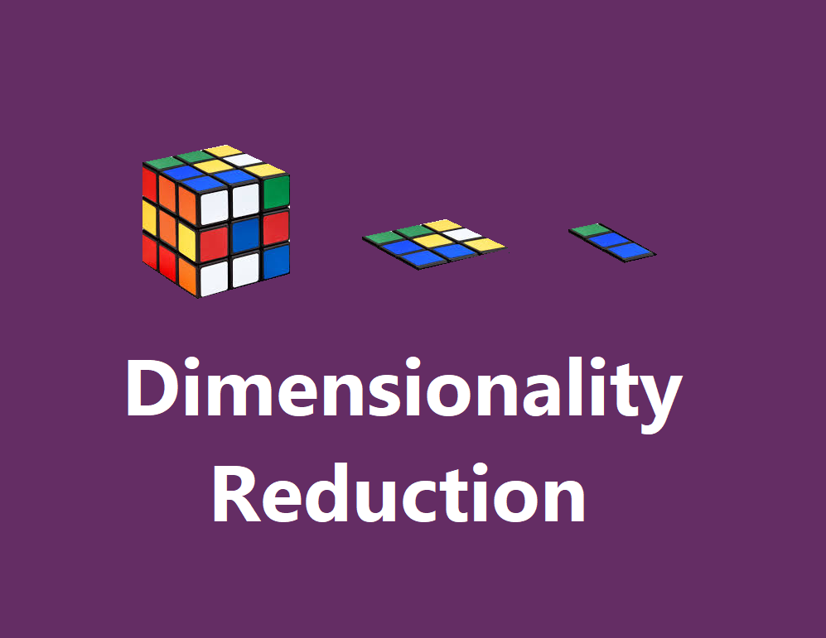
Contents
Dimension reduction
Implementation
Dimension reduction methods
Principal Component Analysis

Slide 4
Introduction to Dimensionality Reduction
Dimensionality reduction seeks a lower-dimensional representation of numerical input data that preserves the salient relationships in the data.
Dimensionality reduction refers to techniques for reducing the number of input variables in training data.
When dealing with high dimensional data, it is often useful to reduce the dimensionality by projecting the data to a lower dimensional subspace which captures the “essence” of the data. This is called dimensionality reduction.

Slide 5
Dimensionality Reduction
In short, Reducing the dimensions from the input data is a must because it helps in faster implementation of algorithms and optimizes the time at which the result can be obtained.

Slide 6
Dimensionality Reduction
Curse of dimensionality:
Irrelevant features
Irrelevant features are the data which is not useful to us.
Redundant features
Redundant features are the duplicate features which just increase the size of data and nothing else.
These irrelevant and redundant features may confuse learner incase of limited training examples, as it leads to overfitting.
To overcome curse of dimensionality: Feature Reduction

Slide 7
Importance
Below listed are some of the points which show the usefulness of data dimensionality reduction:
A lower number of dimensions in data means less training time and less computational resources
Dimensionality reduction avoids the problem of overfitting
Dimensionality reduction can be used to transform non-linear data into a linearly-separable form : (Kernel PCA)
Dimensionality reduction takes care of multicollinearity
Dimensionality reduction can be used for image compression
Dimensionality reduction is extremely useful for data visualization

Slide 8
Dimensionality Reduction Methods
Dimensionality Reduction
Feature Selection
Feature Extraction

Slide 9
Feature Selection
Feature Selection means to selects a subset of features from the original dataset.
Method of Feature Selection:
Selecting uncorrelated features
Selecting the features that are not relevant to the task we are trying to accomplish.
Eliminate irrelevant features
Removing the unwanted features from the data to reduce the data size.

Slide 10
Feature Selection
Univariate methods: (looks at each feature independently of other features)
Pearson correlation coefficient
F-score
Chi-square, etc.
Multivariate methods: (consider all features simultaneously)
Backward Elimination
Forward Selection
Random Forests

Slide 11
Feature Extraction
Uncorrelated features Extraction
Uncorrelated features are extracted
Linear Methods
PCA
FA
LDA
Truncated SVD
Non-Linear Methods
Kernel – PCA
t-SNE
MDS
Isomap

Slide 12
Principal Component Analysis

Slide 13
Principal Component Analysis
PCA is an orthogonal linear transformation that transfers the data to a new coordinate system.
Greatest variance by any projection of the data comes to lie on the first coordinate (first principal component), the second greatest variance lies on the second coordinate (second principal component), and so on.

Slide 14
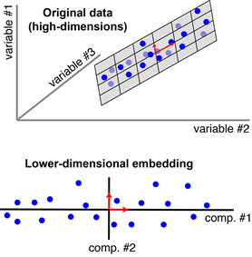
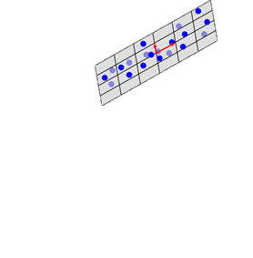
Principal Component Analysis
Variable #1
Variable #3
Variable #2
a). Original data (high - dimensions)
b). Lower dimensional embedding

Slide 15
Steps for Computing PCA
Standardization of the data
Computing the covariance matrix
Calculating the eigenvectors and eigenvalues
Computing the Principal Components
Reducing the dimensions of the data set

Slide 16
Step1: Standardization of data
Scaling the data in such a way that all the features and their values lie within a similar range.
It is calculated as:
$$Z=\frac{feature value −mean}{standard deviation}$$

Slide 17
Step2: Computing the covariance matrix
Covariance matrix expresses the correlation between the different features in the data set.
Essential to identify heavily dependent features because they contain biased and redundant information which reduces the overall performance of the model.

Slide 18
Step2: Computing the covariance matrix contd.
Mathematically a covariance matrix can be written as:
Cnxn = (ci,j), where ci,j = cov(Ai , Aj)
2-Dimensional data set with features a and b, the covariance matrix is a 2×2 matrix as shown below:
$$\begin{matrix}Cov(a,a) & Cov(a,b) \\ Cov(b,a) & Cov(b,b)\end{matrix}$$
Notes:
Cov(a, a) represents the covariance of a variable with itself, which is nothing but the variance of the variable ‘a’
Cov(a, b) represents the covariance of the variable ‘a’ with respect to the variable ‘b’. And since covariance is commutative, Cov(a, b) = Cov(b, a)

Slide 19
Step3: Calculating Eigenvectors and Eigenvalues
Eigenvectors are orthogonal vectors that define a space, the Eigenspace.
Any data point can be described as a linear combination of Eigenvectors.

Slide 20
Step3: Calculating Eigenvectors and Eigenvalues
Eigenvectors of a square matrix have the following property:
$A\vec{v}=λ\vec{v}$
The $λ$ is the eigenvalue.
Eigenvectors of a covariance matrix represents the direction of variance.
Eigenvalues represents the degree of the variance.
Solve the following characteristic equation to calculate the eigenvalues:
det (A-$λ$I) = 0

Slide 21
Step 4: Choosing Principal Components
Order the eigenvectors by the eigenvalues, highest to lowest. This gives you the components in order of significance.
Now, if you like, you can decide to ignore the components of lesser significance. You do lose some information, but if the eigenvalues are small, you don’t lose much.
Form a feature vector by taking the eigenvectors that you want to keep from the list of eigenvectors, and form a matrix with these eigenvectors in the columns.
Feature Vector = ( eig1, eig2,……, eign)

Slide 22
Step 5: Reducing the Dimensions
Choose the components (eigenvectors) that you wish to keep in our data and formed a feature vector, simply take the transpose of the vector and multiply it on the left of the original data set, transposed.
Final Data = (Feature Vector)T * Data Set

Slide 23
Principal Component Analysis
The previous slides contains 5 steps which can be done manually. If one wishes to do this simply then it can be implemented with sklearn library.
The implementation for feature extraction using PCA is shown in next few slides.

Slide 24
Implementation
Implement Feature extraction using PCA.
Importing modules.
from numpy import array
from sklearn.decomposition import PCA
Defining a Matrix with data:
A = array([[1, 2], [3, 4], [5, 6]])
print(A)

Slide 25
Implementation
Creating the PCA instance
pca = PCA(2)
Fit it on data
pca.fit(A)

Slide 26
Implementation
Access values and vectors
print(pca.components_)
print(pca.explained_variance_)
transform data
B = pca.transform(A)
print(B)

Slide 27
Output
[[1 2]
[3 4]
[5 6]]
[[ 0.70710678 0.70710678]
[-0.70710678 0.70710678]]
[8. 0.]
[[-2.82842712e+00 -2.22044605e-16]
[ 0.00000000e+00 0.00000000e+00]
[ 2.82842712e+00 2.22044605e-16]]

Slide 28
Project
Implement Feature extraction using PCA with the following data.
array([[7, 6], [5, 2], [9, 8]])

Slide 29
Reference
https://machinelearningmastery.com/calculate-principal-component-analysis-scratch-python/
https://scikit-learn.org/stable/modules/generated/sklearn.decomposition.PCA.html

Slide 30
Thank You

